Slide 1

IJCAI-17
Customer Flow Forecasts
on Koubei.com
熊伟

Slide 2

1
Statement
2
Preprocessing & Feature Selection
CONTENTS
3
Rule
4
Model Fusion

Slide 3

01
Statement

Slide 4

Statement
Data
shop information data
users pay behavior
users view behavior
The time interval of the log：07.01.2015 to 10.31.2016
The time interval of forecasting：11.01.2016 to 11.14.2016
Forecast target： customer flow per day during the next 14 days for each shop.
Evaluation
:The forecast customer flow of shop I in day t.
:The ground truth customer flow of shop I in day t.

Slide 5
Distribution
Fig.1 The trend of customer flow

Slide 6
Distribution

Slide 7
Modeling
can produce larger data fluctuation because of too little sample
Can't take full advantage of the weather, fog and other information
Cannot use the geographical position etc. Characteristics
Modeling for
Single shop
Modeling for
all shops

Slide 8
Modeling
Shop
Self
Information
User
Weather
location

Slide 9
02
Preprocessing &
Feature Selection

Slide 10
Basic information
To extract the basic features by all shop information and weather conditions
Frequent guest ratio of the store、weekend consumption ratio of the store、trend information and so on.
The characteristics of the store itself.
weather_info
store_info
flow_info

Slide 11
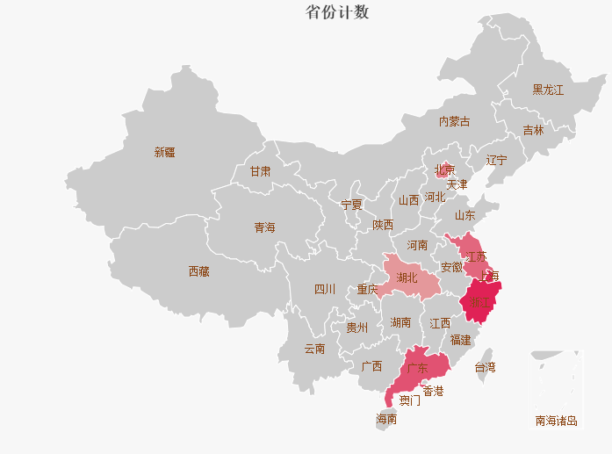
Location feature
Fig.4 Characteristics of Urban Thermal Charts
Count according to the number of cities and take Log, and then equal to discrete 6 intervals

Slide 12
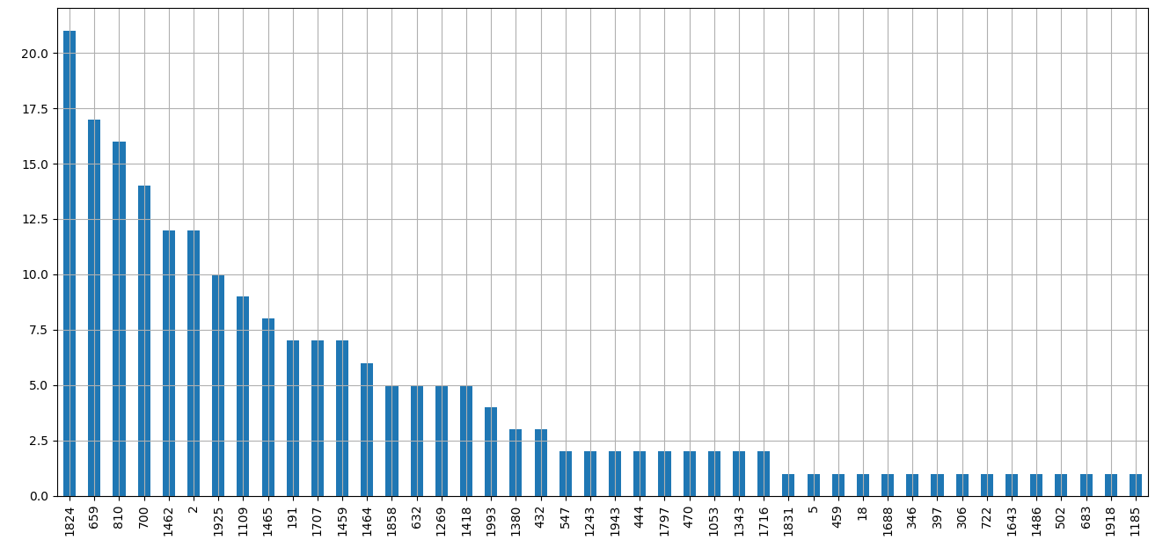
Missing Value
Fig.5 Missing value information

Slide 13
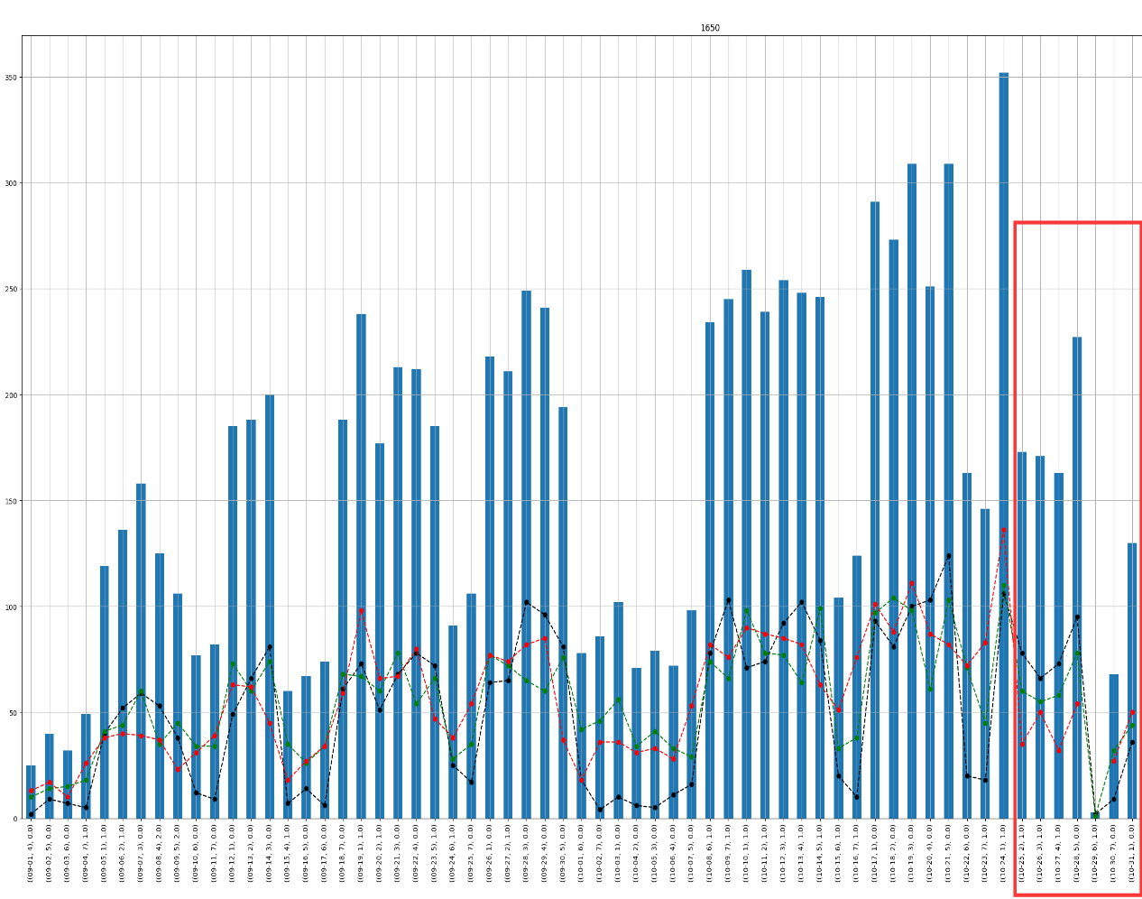
Exception value
Fig.6 Missing value information
For example, shopID1650 last week was exceptionally unusual and we should use it to remove it.

Slide 14
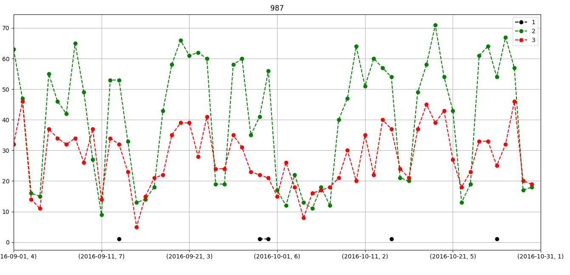
Time discretization
Red line: Customer flow in the morning
Black line: Customer flow in the noon
Green line: Customer flow in the afternoon
The main business hours of the
shop are afternoon
Fig.7 Customer flow distribution of shopID987

Slide 15
03
Rule

Slide 16
Rule
Rule_1
Ratio: Considering the ratio of each Yaori is relatively stable in the current week, so we use this ratio directly.
Base：Choosing the last two weeks as the benchmark，and it will multiply by ratio in forecast.
Rule_2
According to the scoring formulas，we find the minimum value to match with corresponding Yaori.
Rule_3
As the sample is less, so we do the classification of the weather, to achieve the relevant rules.

Slide 17
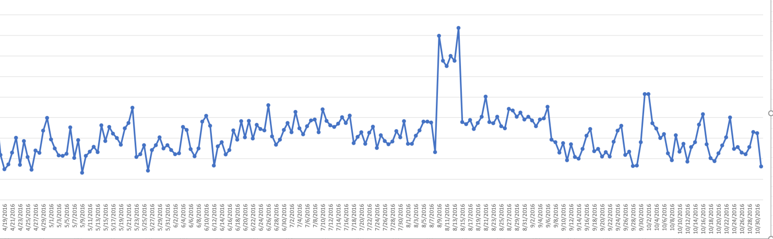
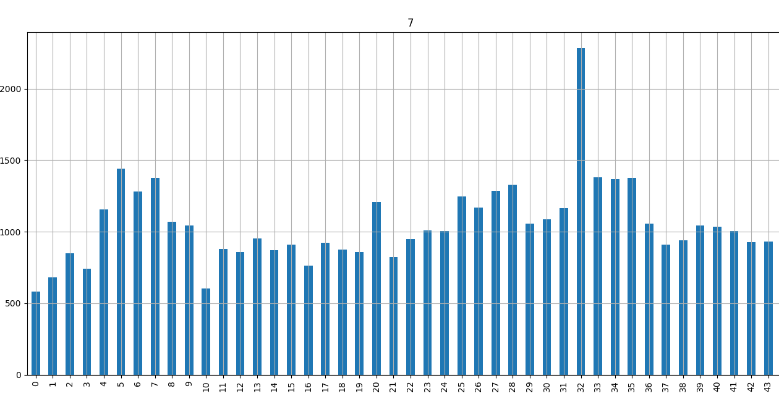
Rule_1 example
Smoothing

Slide 18
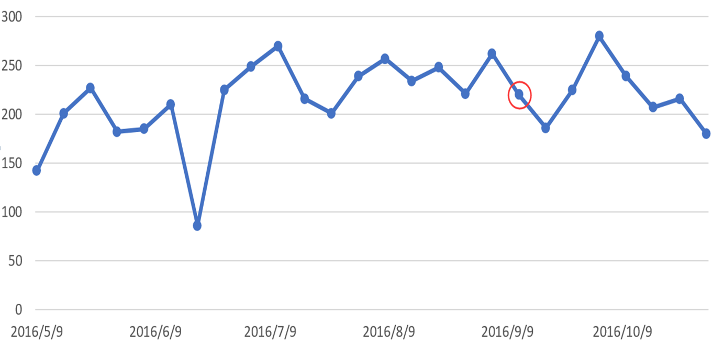
Rule_2 example
Fig.8 shopID1 every Monday customer flow

Slide 19
04
Model Fusion

Slide 20
Model Fusion
XGB
RULE1
RULE2
RULE3
RF
Linear weighting
Output

Slide 21
Summarize
For the time series need a good grasp of the trend
Weather and other information must be fully utilized
Think of a little bit of the meaning of the business may be useful to add, even if not sure.

Slide 22
THANKS

